Slide 1
Unit 3: Tools and methods used in cybercrime

Slide 2
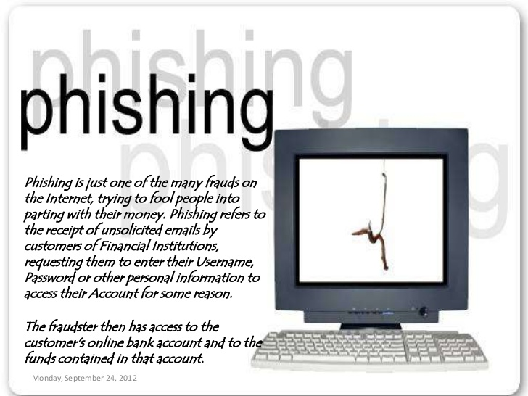

Slide 3
Phishing
Definition: Phishing attacks are the practice of sending fraudulent communications that appear to come from a reputable source. It is usually done through email. The goal is to steal sensitive data like credit card and login information, or to install malware on the victim's machine.
Example: a notice that your email password will expire, with a link to change the password that leads to a malicious website.

Slide 4
How phishing works:
Planning
Set-up
Attack
Collection
Identity theft and fraud

Slide 5
E-mail
Spam email
UBE
UCE
Hoax email:
Hoax warnings are typically ‘scare alerts’ started by malicious people and passed on by users who think they are helping the community by spreading the warning. The most common hoax is the hoax virus.
This usually consists of an email message warning recipients about a new and terribly destructive virus. It ends by suggesting that the reader should warn his or her friends and colleagues, perhaps by simply forwarding the original message to everyone in their address book.
The result is a rapid proliferation of pointless emails that can overload systems.

Slide 6
Methods of phishing:
Dragnet
Rod-and-reel
Lobsterpot
Gillnet

Slide 7
Phishing techniques:
URL manipulation
Filter evasion
Website forgery
Social phishing
Phone phishing

Slide 8
URL manipulation
Examples
1 http://www.icici.bank.com (https://www.icicibank.com)
2 http://www.google.com@members.tripod.com

Slide 9
How to avoid being victim of phishing attack
Keep antivirus update
Do not click on hyperlinks in mails
Use anti-spam software
Verify https
Use anti-spyware software
Get educated
Firewall

Slide 10
Do not enter sensitive or financial information into pop-up windows
Protect against DNS pharming attack

Slide 11
Identity theft
The fraudulent practice of using another person's name and personal information in order to obtain credit, loans, etc.
Victim can suffer various consequences
Punishable under ITA (sec 66C and 66 D)

Slide 12
Myths and facts about ID theft
Identity theft is only a financial crime.
Its my banks fault if I become a victim of Id theft
It is safe to give PI on phone if caller id confirms that it is your bank
I don’t use internet so my PI is not exposed online
There is no way to protect yourself from Id theft.
It is not safe to shop or bank online
Social networking is safe
My PI is not valuable to an Id thief

Slide 13
Personally identifiable information (PII) is information that, when used alone or with other relevant data, can identify an individual.
Personally identifiable information (PII) can be sensitive or non-sensitive.
1. Sensitive personal information includes legal statistics such as:
Full name
Social Security Number (SSN)
Driver’s license
Mailing address
Credit card information
Passport information
Financial information
Medical records

Slide 14
2. Non-sensitive or indirect PII is easily accessible from public sources like phonebooks, the Internet, and corporate directories. Examples of non-sensitive or indirect PII include:
Zip code
Race
Gender
Date of birth
Place of birth
Religion

Slide 15
Information can be classified as
non-classified information
Classified information

Slide 16
Non-classified information:
public information
personal information
routine business information
private information
confidential business information

Slide 17
Classified information:
confidential
secret

Slide 18
Types of Identity Theft
Financial Identity Theft
Financial identity theft is by far the most common type of identity theft.
In 2014, identity thieves stole $16 billion from 12.7 million identity fraud victims, according to Javelin Strategy & Research.
In most cases, the identity thief is trying to get a credit card, loan, or simply buy things by claiming to be someone else.
This can be extremely damaging to a victim’s credit score and their ability to get a loan in the future.
It’s important to check your credit history regularly to ensure it contains accurate information.
If you do not recognize creditors or inquiries against your credit file, this could be a sign of identity theft.

Slide 19
Medical Identity Theft
Medical identity theft occurs when someone uses another individual’s personally identifiable information to fraudulently obtain medical service, prescription drugs or medical insurance coverage.
This type of identity theft can be a costly and complicated crime to resolve.
Ponemon Institute reports that the majority of medical identity theft victims paid an average of $13,500 to resolve the crime.
While most types of identity theft leave victims with financial damage, medical identity theft can also result in the identity thief’s medical history being added to the victim’s medical records.
Inaccurate medical records are difficult to correct and may keep the victim from getting the appropriate insurance coverage or medical care they need.

Slide 20
Criminal Identity Theft
Criminal identity theft usually happens when someone gives false information to police at the time they are arrested.
Sometimes, criminals will get state-issued identity documents using credentials that they have stolen from someone else, or they have simply created a fake ID.
If this type of fraud works, the criminal charges could be filed against the identity theft victim, and the real criminal may be off the hook.
Most victims of criminal identity theft learn about the incidents by chance.
For example, they may receive a court summons, find that their driver’s license has been suspended when they are stopped for minor traffic violations, or possibly through employment background checks.

Slide 21
It can be very difficult for the victim of a criminal identity theft to clear their record.
The steps differ depending on the jurisdiction where the crime occurred.
If the true identity of the criminal cannot be determined, clearing the record can take even more time.
The victim might need to track down the police officers who made the original arrest and prove their own identity.
They may also need to attend a court hearing to be cleared of the charges.
As a result of criminal identity theft, police will sometimes list the victim’s name as an alias for the criminal’s true identity in their records.
Victims of criminal identity theft may often find that some sources still have incorrect criminal records in their databases even after it has been cleared by courts and the police records are corrected.
Because of that, future background checks might even show false criminal records

Slide 22
Child Identity Theft
Child identity theft happens when someone steals or misuses a minor’s personal information.
In many cases, an identity thief starts by using a child’s Social Security number to open lines of credit, obtain driver’s licenses, or even buy a house using a child’s identity.
The Social Security numbers of children are often extremely valuable because they do not have any information associated with them yet. They are a blank slate.
This type of fraud can go undetected for years because most children don’t discover the problem until they become adults.
Sometimes, the impostor can be a family member or a friend who sees an opportunity to claim benefits by using a minor’s identity.
Child identity theft is fairly common and the problem is growing.

Slide 23
Identity Cloning & Concealment
With identity cloning, the identity thief is usually attempting to impersonate someone else so they can simply hide their true identity.
These may be people who are hiding from creditors, illegal immigrants, or people who just want to become “anonymous” for other reasons.
A minor form of this are people who use the photos of someone else on social networks to pose as someone else.
Unlike financial identity theft which is usually exposed when the debts pile up, identity cloning for concealment may go on forever without being detected.
This is especially true if the identity thief can get false credentials to pass authentication tests.

Slide 24
Synthetic Identity Theft
Synthetic identity theft is a type of identity theft where identities are completely or partially fabricated.
This usually means the thief combines a real Social Security number with a name and birthdate that don’t match those listed with the number.
Synthetic identity theft is sometimes more difficult to recognize because it usually doesn’t show up on the victim’s credit report directly.
Often, the credit report becomes a completely new file with the credit bureau or possibly as a sub-file on just one of the victim’s credit reports.
The primary victim of synthetic identity theft are the creditors who grant the lines of credit.
Individual victims are usually affected if their name gets confused with a synthetic identity, or if negative information in a credit report sub-file damages their credit score.

Slide 25
3. Password Cracking
password cracking is the process of recovering passwords from data that have been stored in or transmitted by a computer system.
A common approach (brute-force attack) is to try guesses repeatedly for the password and check them against an available cryptographic hash of the password.

Slide 26
The purpose of password cracking
Help a user recover a forgotten password
To gain unauthorized access to a system,
Or as a preventive measure by System Administrators to check for easily crackable passwords.

Slide 27
Password cracking approaches
Rainbow table approach
Dictionary attack
Brute force attack
Social engineering approach
Shoulder surfing attack

Slide 28
Manual Password Cracking Algorithm
Find a valid user •Create a list of possible passwords •Rank the passwords from high probability to low •Key in each password •If the system allows you in - Success •Else try till success
Passwords can be guessed with knowledge of user’s personal information.

Slide 29
Examples of guessable passwords
Blank
Words like “passcode” ,”password”, “admin”
Series of letters “QWERTY”
User’ s name or login name
Name of the user’s friend/relative/pet
User’s birth place, DOB
Vehicle number, office number ..
Name of celebrity
Simple modification of one of the preceding, suffixing 1 …

Slide 30
Attacker can write a code to check all possible passwords in the list
(Manual cracking)
Limitations :
Time consuming
Not usually effective
Passwords are stored in database-password verification process-system
Ensure confidentiality-password verification data is not stored in clear text format-encryption, cryptographic hash function used
Authentication process

Slide 31
Password cracking tools
Default password
Oxid.it/cain.html
Freeworld.thc.org/thc-hydra
Aircrack-ng
LoPHCrack
Airsnort
solarwinds

Slide 32
Pwdump
Rainbowcrack
brutus
John the Ripper
ophcrack
cain and abel
lophtcrack
THC-Hydra

Slide 33
Categories of password cracking attacks:
Online attacks
Offline attacks
Non-electronic attacks
Social engineering
Shoulder surfing
Dumpster diving

Slide 34
Online attacks
An attacker may create a script- automated program- to try each password
Most popular online attack;- man-in-the-middle attack or bucker-brigade attack
Used to obtain passwords for E-mail accounts on public websites like gmail, yahoomail
Also to get passwords for financial websites

Slide 35
Offline attacks
Are performed from a location other than the target where these passwords reside or are used
Require physical access to the computer and copying the password

Slide 36
Types of Password Attacks
Password Guessing
Attackers can guess passwords locally or remotely using either a manual or automated approach
Dictionary attacks
work on the assumption that most passwords consist of whole words, dates, or numbers taken from a dictionary.
Hybrid password
assume that network administrators push users to make their passwords at least slightly different from a word that appears in a dictionary.

Slide 37
Weak passwords
The password contains less than eight characters
The password is a word found in a dictionary (English or foreign)
The password is a common usage word such as:
Names of family, pets, friends, co-workers, fantasy characters, etc.
Computer terms and names, commands, sites, companies, hardware, software.
The words "<Company Name>", "sanjose", "sanfran" or any derivation.
Birthdays and other personal information such as addresses and phone numbers.
Word or number patterns like aaabbb, qwerty, zyxwvuts, 123321, etc.
Any of the above spelled backwards.
Any of the above preceded or followed by a digit (e.g., secret1,1secret

Slide 38
Strong Passwords
Contain both upper and lower case characters (e.g., a-z, A-Z)
Have digits and punctuation characters as well as letters e.g., 0-9, @#$%^&*()_+|~-=\`{}[]:";'<>?,./)
Are at least eight alphanumeric characters long.
Are not a word in any language, slang, dialect, jargon, etc.
Are not based on personal information, names of family, etc.
Passwords should never be written down or stored on-line.
Try to create passwords that can be easily remembered.
One way to do this is create a password based on a song title, affirmation, or other phrase.
For example, the phrase might be: "This May Be One Way To Remember"
and the password could be: "TmB1w2R!" or "Tmb1W>r~" or some other variation.

Slide 39
Random passwords
Combination of lower case, upper case, numbers, symbols
But difficult to remember
Need to write down
Makes it more vulnerable

Slide 40
Guidelines for secure password
Secure Password Generator
Password Length: min …
Include Symbols:( e.g. @#$% )
Include Numbers: ( e.g. 123456 )
Include Lowercase Characters: ( e.g. abcdefgh )
Include Uppercase Characters: ( e.g. ABCDEFGH )
Exclude Similar Characters:( e.g. i, l, 1, L, o, 0, O )
Exclude Ambiguous Characters:( { } [ ] ( ) / \ ' " ` ~ , ; : . < > )

Slide 41
Generate On The Client Side
( do NOT send across the Internet )
Auto-Select:
( select the password automatically )
Save My Preference:
( save all the settings above for later use )
Load My Settings Anywhere:
URL to load my settings on other computers quickly
Your New Password:
Remember your password:
Remember your password with the first letters of each word in this sentence.

Slide 42
To prevent your passwords from being hacked by social engineering, brute force or dictionary attack method, you should notice that:
1. Do not use the same password for multiple important accounts.
2. Use a password that has at least 16 characters, use at least one number, one uppercase letter, one lowercase letter and one special symbol.
3. Do not use the names of your families, friends or pets in your passwords.
4. Do not use postcodes, house numbers, phone numbers, birthdates, ID card numbers, social security numbers, and so on in your passwords.
5. Do not use any dictionary word in your passwords.
6. Do not use something that can be cloned( but you can't change ) as your passwords, such as your fingerprints.
7. Do not let your Web browsers( FireFox, Chrome, Safari, Opera, IE ) store your passwords, since all passwords saved in Web browsers can be revealed easily.
8. Do not log in to important accounts on the computers of others, or when connected to a public Wi-Fi hotspot, Tor, free VPN or web proxy.

Slide 43
9. Do not send sensitive information online via HTTP or FTP connections, because messages in these connections can be sniffed with very little effort. You should use encrypted connections such as HTTPS and SFTP whenever possible.
10. When travelling, you can encrypt your Internet connections before they leave your laptop, tablet, mobile phone or router. For example, you can set up a private VPN on your own server( home computer, dedicated server or VPS ) and connect to it. Alternatively, you can set up an encrypted SSH tunnel between your router and your home computer( or a remote server of your own ) with PuTTY and connect your programs( e.g. FireFox ) to PuTTY. Then even if somebody captures your data as it is transmitted between your device( e.g. laptop, iPhone, iPad ) and your server with a packet sniffer, he'll won't be able to steal your data and passwords from the encrypted streaming data.
11. How secure is my password? Perhaps you believe that your passwords are very strong, difficult to hack. But if a hacker has stolen your username and the MD5 hash value of your password from a company's server, and the rainbow table of the hacker contains this MD5 hash, then your password will be cracked quickly.
To check the strength of your passwords and know whether they're inside the popular rainbow tables, you can convert your passwords to MD5 hashes on this MD5 hash generator, then decrypt your passwords by submitting these hashes to an online MD5 decryption service. For instance, your password is "0123456789A", using the brute-force method, it may take a computer almost one year to crack your password, but if you decrypt it by submitting its MD5 hash( C8E7279CD035B23BB9C0F1F954DFF5B3 ) to a MD5 decryption website, how long will it take to crack it? You can perform the test yourself.

Slide 44
12. It's recommended to change your passwords every 10 weeks.
13. It's recommended that you remember a few master passwords, store other passwords in a plain text file and encrypt this file with 7-Zip, GPG or a disk encryption software such as BitLocker, or manage your passwords with a password management software.
14. Encrypt and backup your passwords to different locations, then if you lost access to your computer or account, you can retrieve your passwords back quickly.
15. Turn on 2-step authentication whenever possible.
16. Do not store your critical passwords in the cloud.
17. Access important websites( e.g. Paypal ) from bookmarks directly, otherwise please check its domain name carefully, it's a good idea to check the popularity of a website with Alexa toolbar to ensure that it's not a phishing site before entering your password.
18. Protect your computer with firewall and antivirus software, download software from reputable sites only, and verify the MD5 or SHA1 checksum of the installation package whenever possible.
19. Be careful when using online paste tools and screen capture tools, do not let them to upload your passwords to the cloud.
20. If there are important files on your computer, and it can be accessed by others, check if there are hardware keyloggers( e.g. wireless keyboard sniffer ), software keyloggers and hidden cameras when you feel it's necessary.
21. If you're a webmaster, do not store the users passwords in the database, you should store the salted hash values of passwords inste

Slide 45
4. keyloggers
Keystroke logging, often referred to as keylogging or keyboard capturing, is the action of recording (or logging) the keys struck on a keyboard, typically in a covert manner so that the person using the keyboard is unaware that their actions are being monitored.
It has uses in the study of human–computer interaction.
There are numerous keylogging methods, ranging from hardware and software-based approaches to acoustic analysis.

Slide 46
Software-based keyloggers
Software-based keyloggers use the target computer’s operating system in various ways, including: imitating a virtual machine, acting as the keyboard driver (kernel-based), using the application programming interface to watch keyboard strokes (API-based), recording information submitted on web-based forms (Form Grabber based) or capturing network traffic associated with HTTP POST events to steal passwords (Packet analyzers).
Usually consists of two files DLL and EXE

Slide 47
Examples of software keyloggers
Sc-keylog PRO
Spytech spyAgent stealth
All in one keylogger
Refer pg no 138, cyber security

Slide 48
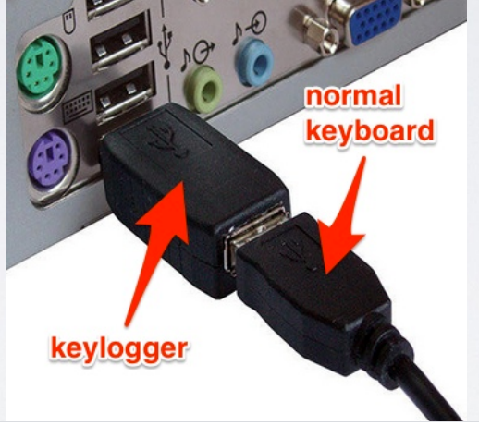
Hardware keyloggers
installing a hardware circuit between the keyboard and the computer that logs keyboard stroke activity (keyboard hardware).
Target- ATMs

Slide 49
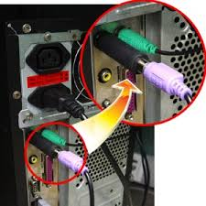
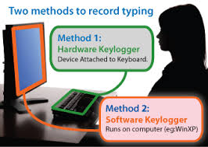

Slide 50
Examples of hardware keyloggers:
keyboard hardware
wireless keyboard sniffers
keyboard overlays

Slide 51
Acoustic keylogging
Acoustic keylogging monitors the sound created by each individual keystroke and uses the subtly different acoustic signature that each key emits to analyze and determine what the target computer’s user is typing.
A keyboard acoustic emanations attack is a form of a side-channel attack where an attacker extracts what a victim typed on his or her keyboard using just the audio signal of the typing.

Slide 52
Such a keylogging attack can result in passwords and confidential information being stolen from just a compromised microphone, and thus has severe security implications.

Slide 53
AntiKeylogger
An anti-keylogger (or anti–keystroke logger) is a type of software specifically designed for the detection of keystroke logger software; often, such software will also incorporate the ability to delete or at least immobilize hidden keystroke logger software on your computer.

Slide 54
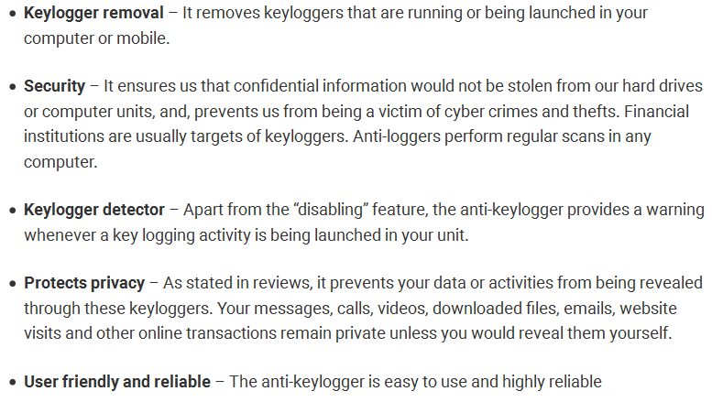
Benefits of Anti-keyloggers

Slide 55
Does not require regular updates like other antispy programs.
Prevents internet banking frauds
Prevents ID theft
Secures e-mails and instant messaging or chatting

Slide 56
Malware can be classified as
Viruses and worms
Trojan horses
Rootkits
Backdoors
Spyware
Botnets
Keystroke loggers

Slide 57
Spywares
Type of Malware…..
Spyware is software that aims to gather information about a person or organization without their knowledge and that may send such information to another entity without the consumer's consent, or that asserts control over a computer without the consumer's knowledge.
Secretly installed and monitors
Collect PI of victim
Change computer settings

Slide 58
Examples of spyware
007 spy
Spector pro
eBlaster
Remote spy
flexispy

Slide 59
5. Virus and Worms
A computer virus is a malware program that, when executed, replicates by inserting copies of itself (possibly modified) into other computer programs, data files, or the boot sector of the hard drive; when this replication succeeds, the affected areas are then said to be "infected".

Slide 60
Virus spread through
The internet
A stand alone PC
Local networks

Slide 61
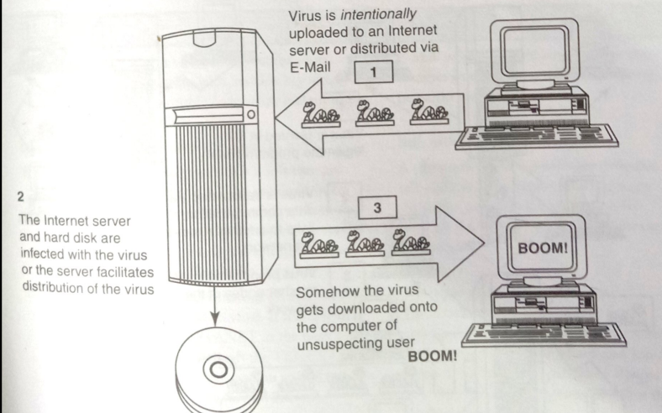

Slide 62
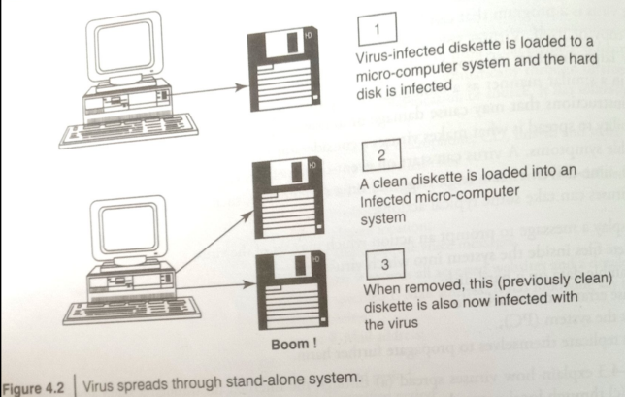

Slide 63
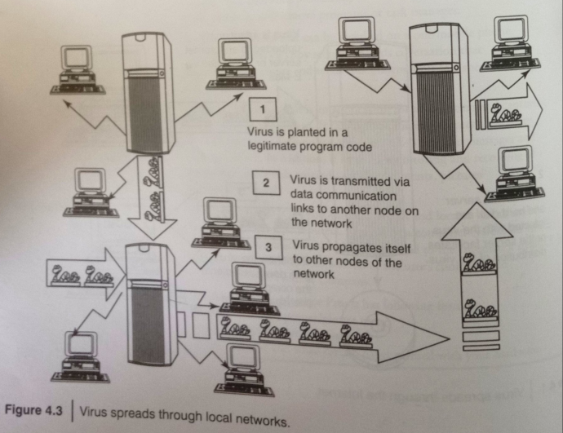

Slide 64
Some typical virus actions
Display a message to prompt an action
Delete files in the system
Scramble data on a hard disk
Cause erratic screen behavior
Halt the system
Replicate themselves to propagate further harm

Slide 65
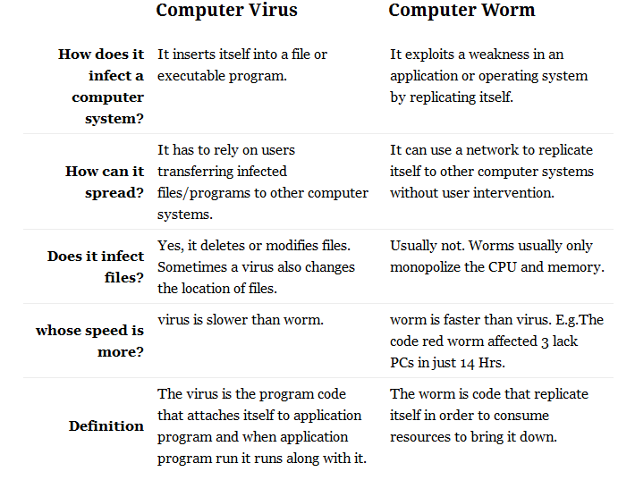
Difference between virus and worm

Slide 66
Types of viruses
Boot sector viruses: MBR
Program viruses: executable files
Multipartite viruses: combination of two
Stealth viruses
Polymorphic viruses
Macroviruses
Active X and Java contrl

Slide 67
Boot sector viruses
A boot sector virus is a computer virus that infects a storage device's master boot record (MBR).
It is not mandatory that a boot sector virus successfully boot the victim's PC to infect it.
As a result, even non-bootable media can trigger the spread of boot sector viruses.
These viruses copy their infected code either to the floppy disk's boot sector or to the hard disk's partition table. During start-up, the virus gets loaded to the computer's memory. As soon as the virus is saved to the memory, it infects the non-infected disks used by the system.
The propagation of boot sector viruses has become very rare since the decline of floppy disks. Also, present-day operating systems include boot-sector safeguards that make it difficult for boot sector viruses to infect them.

Slide 68
Program viruses
A program virus becomes active when the program file (usually with extensions .BIN, .COM, .EXE, .OVL, .DRV) carrying the virus is opened.
Once active, the virus will make copies of itself and will infect other programs on the computer.

Slide 69
Multipartite viruses
A multipartite virus is a fast-moving virus that uses file infectors or boot infectors to attack the boot sector and executable files simultaneously.
Most viruses either affect the boot sector, the system or the program files.
The multipartite virus can affect both the boot sector and the program files at the same time, thus causing more damage than any other kind of virus.
When the boot sector is infected, simply turning on the computer will trigger a boot sector virus because it latches on to the hard drive that contains the data that is needed to start the computer. Once the virus has been triggered, destructive payloads are launched throughout the program files.
A multipartite virus infects computer systems multiple times and at different times. In order for it to be eradicated, the entire virus must be removed from the system.
A multipartite virus is also known as a hybrid virus.

Slide 70
Stealth viruses
A stealth virus is a hidden computer virus that attacks operating system processes and averts typical anti-virus or anti-malware scans. Stealth viruses hide in files, partitions and boot sectors and are adept at deliberately avoiding detection. Stealth virus eradication requires advanced anti-virus software or a clean system reboot.

Slide 71
Polymorphic viruses
A polymorphic virus is a complicated computer virus that affects data types and functions.
It is a self-encrypted virus designed to avoid detection by a scanner.
Upon infection, the polymorphic virus duplicates itself by creating usable, albeit slightly modified, copies of itself.
Polymorphism, in computing terms, means that a single definition can be used with varying amounts of data. In order for scanners to detect this type of virus, brute-force programs must be written to combat and detect the polymorphic virus with novel variant configurations.

Slide 72
Macro viruses
A macro virus is a computer virus that "infects" a Microsoft Word or similar application and causes a sequence of actions to be performed automatically when the application is started or something else triggers it.

Slide 73
Active X and Java control
ActiveX and Java were created for web page designers to incorporate a wide array of impressive effects on web pages, giving movement and added dimension to the previously "flat" web pages.
To operate properly, these ActiveX controls and Java applets need to gain access to your hard disk. Insufficient memory and bandwidth problems necessitate this approach. Although this desktop access provides a wealth of beneficial applications of these controls and applets, malicious code developers have the same access. They are now using it to read and delete or corrupt files, access RAM, and even access files on computers attached via a LAN.

Slide 74

Trojan horses and Backdoors
A Trojan horse, or Trojan, in computing is generally a non-self-replicating type of malware program containing malicious code that, when executed, carries out actions determined by the nature of the Trojan, typically causing loss or theft of data, and possible system harm.

Slide 75
It is a type of malware that typically gets hidden as an attachment in an email or a free-to-download file, then transfers onto the user’s device.
Once downloaded, the malicious code will execute the task the attacker designed it for, such as gain backdoor access to corporate systems, spy on users’ online activity, or steal sensitive data.
Indications of a Trojan being active on a device include unusual activity such as computer settings being changed unexpectedly.

Slide 76
Examples of threats by trojans
Erase, overwrite or corrupt data on a computer
Help to spread other malware such as viruses- dropper trojan
Deactivate or interface with antivirus and firewall programs
Allow remote access to your computer- remote access trojan
Upload and download files
Gather E-mail address and use for spam
Log keystrokes to steal information – pwds, CC numbers
Copy fake links to false websites
slowdown, restart or shutdown the system
Disable task manager
Disable the control panel

Slide 77

Backdoors
A backdoor in a computer system is a method of bypassing normal authentication, securing unauthorized remote access to a computer, obtaining access to plaintext, and so on, while attempting to remain undetected.
Also called a trapdoor. An undocumented way of gaining access to a program, online service or an entire computer system.
The backdoor is written by the programmer who creates the code for the program. It is often only known by the programmer. A backdoor is a potential security risk.

Slide 78
Functions of backdoors
Allows an attacker to
create, delete, rename, copy or edit any file
Execute commands to change system settings
Alter the windows registry
Run, control and terminate applications
Install arbitrary software and parasites
Control computer hardware devices,
Shutdown or restart computer

Slide 79
Functions of backdoors
Steals sensitive personal information, valuable documents, passwords, login name…
Records keystrokes, captures screenshots
Sends gathered data to predefined E-mail addresses
Infects files, corrupts installed apps, damages entire system
Distributes infected files to remote computers
Installs hidden FTP server
Degrades internet connection and overall system performance
Decreases system security
Provides no uninstall feature, hides processes, files and other objects

Slide 80
Examples of Backdoor trojans
Back Orifice : for remote system administration
Bifrost : can infect Win95 through Vista, execute arbitrary code
SAP backdoors : infects SAP business objects
Onapsis Bizploit: Onapsis Bizploit is an SAP penetration testing framework to assist security professionals in the discovery, exploration, vulnerability assessment and exploitation phases of specialized SAP security assessment

Slide 81
How to protect from Trojan Horses and backdoors
Stay away from suspect websites/ links
Surf on the web cautiously : avoid P2P networks
Install antivirus/ Trojan remover software

Slide 82
7. Steganography
Steganography (from Greek steganos, or "covered," and graphien, or "writing") is the hiding of a secret message within an ordinary message and the extraction of it at its destination.
Steganography takes cryptography a step farther by hiding an encrypted message so that no one suspects it exists. Ideally, anyone scanning your data will fail to know it contains encrypted data.
Other names: data hiding, information hiding, digital watermarking

Slide 83
Difference between steganography and cryptography
Cryptography is the study of hiding information, while Steganography deals with composing hidden messages so that only the sender and the receiver know that the message even exists.
In Steganography, only the sender and the receiver know the existence of the message, whereas in cryptography the existence of the encrypted message is visible to the world.
Due to this, Steganography removes the unwanted attention coming to the hidden message.
Cryptographic methods try to protect the content of a message, while Steganography uses methods that would hide both the message as well as the content.
By combining Steganography and Cryptography one can achieve better security.

Slide 84
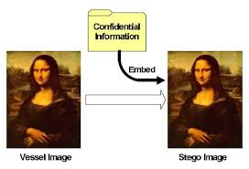
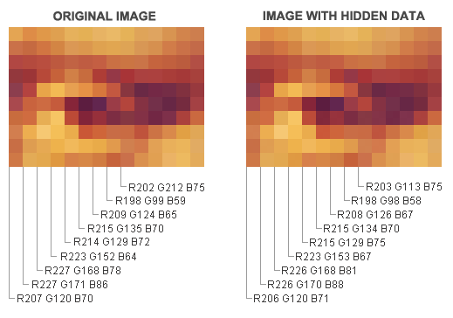

Slide 85
Digital watermarking
Digital watermarking is the act of hiding a message (trademark) related to a digital signal (i.e. an image, song, video) within the signal itself.
It is a concept closely related to steganography, in that they both hide a message inside a digital signal.
However, what separates them is their goal.
Watermarking tries to hide a message related to the actual content of the digital signal.
while in steganography the digital signal has no relation to the message, and it is merely used as a cover to hide its existence.

Slide 86
Steganography is used for secret communication, whereas Watermarking is used for content protection, copyright management, content authentication and tamper detection.

Slide 87
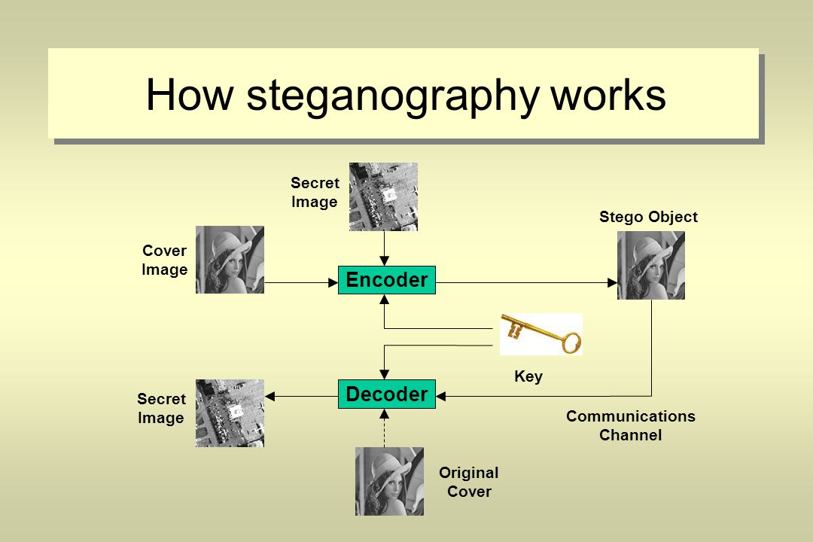
How steganography works

Slide 88
Types of steganography:
Image steganography
Audio steganography
Video steganography
Text steganography

Slide 89
Steganography tools
Disi-steganography
Invisible folders
Invisible secrets
Stealth files
Hermetic stego
Drive crypt plus(DCCP)
MP3stego
Mp3 video

Slide 90
Steganalysis
Steganalysis is the study of detecting messages hidden using steganography;
The goal of steganalysis is to identify suspected packages, determine whether or not they have a payload encoded into them, and, if possible, recover that payload.

Slide 91
Steganalysis tools
stegAlyzerAS
stegAlyzerSS
Stegspy
Stegdetect
Stegsecret
Virtual steganographic lab(VSL)

Slide 92
8.DoS and DDoS attacks
In computing, a denial-of-service (DoS) or distributed denial-of-service (DDoS) attack is an attempt to make a machine or network resource unavailable to its intended users.
A DoS attack generally consists of efforts to temporarily or indefinitely interrupt or suspend services of a host connected to the Internet.

Slide 93
Symptoms of DoS attacks
Slow network performance
Unavailability of a particular website
Inability to access any website
Dramatic increase in number of Spam E-mails received

Slide 94
A DoS attack may do the following
Flood the traffic, thereby preventing legitimate traffic
Disrupt connections between two systems- preventing access to service
Prevent a particular individual from accessing a service
Disrupt service to a specific system or person

Slide 95
Classification of DoS
Volume based attacks/Bandwidth attack
Ping flood attack
TCP SYN flood attack
UDP flood attack
Protocol Attacks
Ping of death
Smurf attack
Application layer attacks

Slide 96
Volume based(Bandwidth) attacks
The most common DoS attacks
target the computer's network bandwidth or connectivity.
Bandwidth attacks flood the network with such a high volume of traffic, that all available network resources are consumed and legitimate user requests can not get through.
Includes UDP, ICMP and other spoofed packet floods.
Goal: saturate bandwidth of attacked site.

Slide 97
Flood attack
Flooding is a Denial of Service (DoS) attack that is designed to bring a network or service down by flooding it with large amounts of traffic.
Flood attacks occur when a network or service becomes so weighed down with packets initiating incomplete connection requests that it can no longer process genuine connection requests.
By flooding a server or host with connections that cannot be completed, the flood attack eventually fills the hosts memory buffer. Once this buffer is full no further connections can be made, and the result is a Denial of Service.

Slide 98
SYN attack
A SYN flood occurs when a host sends a flood of TCP/SYN packets, often with a forged sender address.
Each of these packets are handled like a connection request, causing the server to generate a half-open connection, by sending back a TCP/SYN-ACK packet (Acknowledge), and waiting for a packet in response from the sender address (response to the ACK Packet).
However, because the sender address is forged, the response never comes. These half-open connections saturate the number of available connections the server can make, keeping it from responding to legitimate requests until after the attack ends

Slide 99
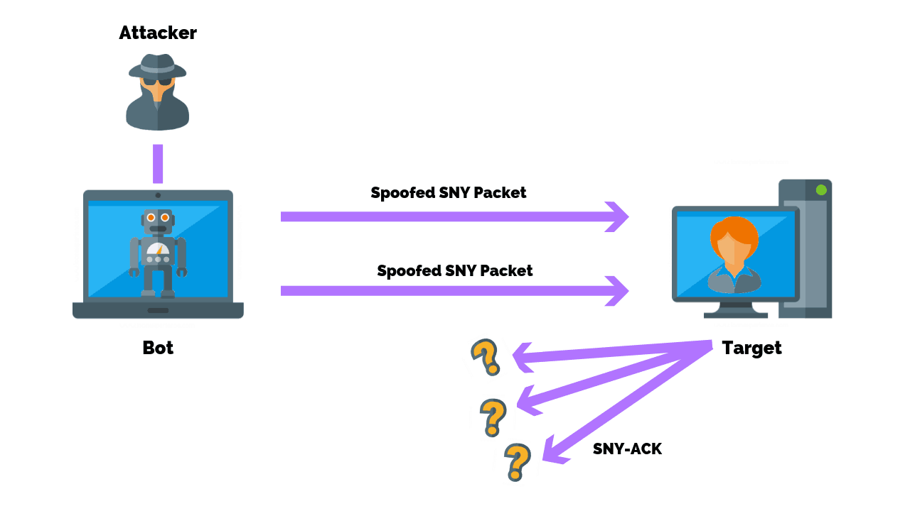
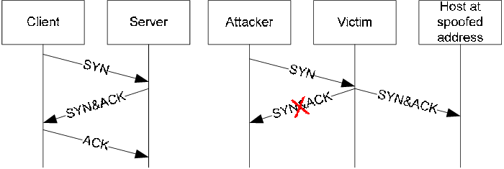
SYN attack

Slide 100
2. Protocol attacks
Denial of service attacks may take advantage of certain standard protocol features.
Several attacks capitalize on the fact that IP source addresses can be spoofed.
In addition, connection depletion attacks take advantage of the fact that many connection-oriented protocols require servers to maintain state information after a connection request is made but before the connection is fully established.
The most common connection depletion attack is SYN flooding

Slide 101
Ping of death attack
Ping of death is a denial of service (DoS) attack caused by an attacker deliberately sending an IP packet larger than the 65,536 bytes allowed by the IP protocol.

Slide 102
Smurf attack
A smurf attack is a type of denial of service attack in which a system is flooded with spoofed ping messages.
This creates high computer network traffic on the victim’s network, which often renders it unresponsive.

Slide 103
Unintentional DoS attack
This describes a situation where a website ends up denied, not due to a deliberate attack by a single individual or group of individuals, but simply due to a sudden enormous spike in popularity.
This can happen when an extremely popular website posts a prominent link to a second, less well-prepared site, for example, as part of a news story.

Slide 104
3. Application Layer attacks
Low and slow attacks
targets windows and loopholes more
Goal: crash server
target is flooded with incoming requests and responses for files, images etc
DoS occurs due to additional requests from legitimate traffic sources.

Slide 105
Logic attacks
An attacker sends more requests to a server than it can handle, usually in a relentless manner, until the server buckles and gives in to the attacker. Once this type of attack ends, the server can return to normal operation.
Generally, a logic attack requires your server to have a discoverable weakness that the attacker can locate and then use against it.
Because of this prerequisite, it is usually easy to prevent by keeping your server software and hardware up-to-date with the latest security patches and firmware respectively

Slide 106
Teardrop attack
A teardrop attack is a denial of service (DoS) attack conducted by targeting TCP/IP fragmentation reassembly codes.
This attack causes fragmented packets to overlap one another on the host receipt;
the host attempts to reconstruct them during the process but fails.
Heavy payloads are sent to the machine that is being targeted, causing system crashes.

Slide 107
Tools used to launch Dos attack
Jolt2
Nemesy
Targa
Crazypinger
sometrouble

Slide 108
DDoS attack
A Distributed Denial of Service (DDoS) attack is an attempt to make an online service unavailable by overwhelming it with traffic from multiple sources.
They target a wide variety of important resources, from banks to news websites, and present a major challenge to making sure people can publish and access important information.

Slide 109
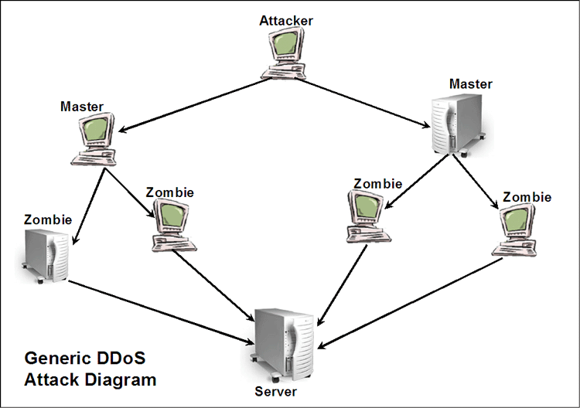

Slide 110
Tools used to launch DDoS attacks
Trinoo
Tribe flood network
Stachedraht
Shaft
Mstream

Slide 111
How to prevent dos/ddos attacks
Filtering: Routers at the edge of the network can be trained to spot and drop DDOS connections, preventing them from slowing the network or the server.
Moving: If the attack is pointed at a specific IP address, the site’s IP can be changed.
Blackholing: A host may simply “blackhole” a site that is being DDOSed, directing all traffic to it to an address that doesn’t exist. This is normally a last resort.

Slide 112
Buy more bandwidth
Build redundancy in your architecture
configure your network hardware against DDoS attacks
Deploy anti-DoS hardware and software modules
Deploy DDoS protection appliance

Slide 113
Tools used for detection of Dos and DDoS attacks
Zombizapper
Remote intrusion detector
SARA
Find_Ddos
DDosping

Slide 114

9. SQL Injection
SQL injection is a code injection technique, used to attack data-driven applications, in which malicious SQL statements are inserted into an entry field for execution (e.g. to dump the database contents to the attacker).
It is the type of attack that takes advantage of improper coding of your web applications that allows hacker to inject SQL commands into say a login form to allow them to gain access to the data held within your database.

Slide 115
What an attacker can do?
* ByPassing Logins : by obtaining username and passwords
* Accessing secret data : reconnaissance
* Adding new data or Modifying contents of website: INSERT/UPDATE
* Shutting down the My SQL server

Slide 116
Types of SQL injection attacks
Piggy backed queries
Tautologies
Union query

Slide 117
Steps for SQL Injection attack
Step 1: Finding Vulnerable Website:
find the Vulnerable websites(hackable websites) using Google Dork list.
google dork is searching for vulnerable websites using the google searching tricks
use “inurl:” command for finding the vulnerable websites.
Some Examples: inurl:index.php?id= inurl:gallery.php?id= inurl:article.php?id= inurl:pageid=
How to use? copy one of the above command and paste in the google search engine box. Hit enter. You can get list of websites. We have to visit the websites one by one for checking the vulnerability.

Slide 118
Step 2: Checking the Vulnerability:
Now we should check the vulnerability of websites.
In order to check the vulnerability ,add the single quotes(‘) at the end of the url and hit enter.
For eg: http://www.victimsite.com/index.php?id=2'
If the page remains in same page or showing that page not found or showing some other webpages. Then it is not vulnerable.
If it showing any errors which is related to sql query, then it is vulnerable.

Slide 119
Step 3: Finding Number of columns:
Now we have found the website is vulnerable.
Next step is to find the number of columns in the table. For that replace the single quotes(‘) with “order by n” statement
Change the n from 1,2,3,4,,5,6,…n. Until you get the error like “unknown column “.
For eg:
http://www.victimsite.com/index.php?id=2 order by 1 http://www.victimsite.com/index.php?id=2 order by 2 http://www.victimsite.com/index.php?id=2 order by 3 http://www.victimsite.com/index.php?id=2 order by 4
…..
http://www.victimsite.com/index.php?id=2 order by 8(error)
so now x=8 , The number of column is x-1 i.e, 7.

Slide 120
Step 4: Displaying the Vulnerable columns:
Using “union select columns_sequence” we can find the vulnerable part of the table. Replace the “order by n” with this statement.
And change the id value to negative
Replace the columns_sequence with the no from 1 to x-1(number of columns) separated with commas(,).
For eg: if the number of columns is 7 ,then the query is as follow:
http://www.victimsite.com/index.php?id=-2 union select 1,2,3,4,5,6,7—

Slide 121
Blind SQL injection
Blind SQL Injection is used when a web application is vulnerable to an SQL injection but the results of the injection are not visible to the attacker.
The page with the vulnerability may not be one that displays data but will display differently depending on the results of a logical statement injected into the legitimate SQL statement called for that page.
This type of attack can become time-intensive because a new statement must be crafted for each bit recovered.
There are several tools that can automate these attacks once the location of the vulnerability and the target information has been established

Slide 122
Tools for SQL server penetration
Netsparker
Acutenix
BSQL Hacker
SQLmap
SQLninja

Slide 123
How to prevent SQL Injection attacks
Input validation
Replace all single quotes to two single quotes
Sanitize the input: clean characters like ;, --, select, etc
Numeric values should be checked while accepting a query string value
Keep all text boxes and form fields short
Modify error reports
SQL errors should not be displayed to the outside world
Other preventions
Never use default system accounts for SQL server 2000
Isolate database server and webserver: different machines
Extended stored procedures, user defined functions should be moved to an isolated server.

Slide 124
10. Buffer overflow
In computer security and programming, a buffer overflow, or buffer overrun, is an anomaly where a program, while writing data to a buffer, overruns the buffer's boundary and overwrites adjacent memory. This is a special case of violation of memory safety.
This may result in erratic program behavior
Buffer overflows are not easy to discover and even when one is discovered, it is generally extremely difficult to exploit.

Slide 125
In a classic buffer overflow exploit, the attacker sends data to a program, which it stores in an undersized stack buffer. The result is that information on the call stack is overwritten, including the function's return pointer.
The data sets the value of the return pointer so that when the function returns, it transfers control to malicious code contained in the attacker's data.
At the code level, buffer overflow vulnerabilities usually involve the violation of a programmer's assumptions.
Many memory manipulation functions in C and C++ do not perform bounds checking and can easily overwrite the allocated bounds of the buffers they operate upon.
Even bounded functions, such as strncpy(), can cause vulnerabilities when used incorrectly.
The combination of memory manipulation and mistaken assumptions about the size or makeup of a piece of data is the root cause of most buffer overflows.

Slide 126
Example
The code in this example also relies on user input to control its behavior, but it adds a level of indirection with the use of the bounded memory copy function memcpy().
This function accepts a destination buffer, a source buffer, and the number of bytes to copy. The input buffer is filled by a bounded call to read(), but the user specifies the number of bytes that memcpy() copies.
... char buf[64], in[MAX_SIZE];
printf("Enter buffer contents:\n");
read(0, in, MAX_SIZE-1);
printf("Bytes to copy:\n");
scanf("%d", &bytes);
memcpy(buf, in, bytes); ...
Note: This type of buffer overflow vulnerability (where a program reads data and then trusts a value from the data in subsequent memory operations on the remaining data) has turned up with some frequency in image, audio, and other file processing libraries.

Slide 127
Types of buffer overflow
stack-based buffer overflow
Heap buffer overflow
NOPs

Slide 128
stack-based buffer overflow
A stack-based buffer overflow condition is a condition where the buffer being overwritten is allocated on the stack.
Characteristics:
Attack may exploit this to manipulate the program by
Changing the local variable
Changing the return address
Changing the function pointer or exception handler

Slide 129
Heap buffer overflow
A heap overflow is a type of buffer overflow that occurs in the heap data area.
Heap overflows are exploitable in a different manner to that of stack-based overflows.
Memory on the heap is dynamically allocated by the application at run-time and typically contains program data.
Exploitation is performed by corrupting this data in specific ways to cause the application to overwrite internal structures such as linked list pointers.
The canonical heap overflow technique overwrites dynamic memory allocation linkage (such as malloc meta data) and uses the resulting pointer exchange to overwrite a program function pointer.

Slide 130
How to minimize buffer overflow
Assessment of secure code manually
Disable stack execution
Compiler tools
Dynamic run-time checks
Various tools are used to detect/ defend buffer overflow
stackGaurd
Propolice
LibSafe

Slide 131
10. Attacks on wireless networks
Nowadays employees can work from anywhere
Boundaryless
Computing anywhere anytime era

Slide 132
Traditional techniques of attacks on wireless network
Sniffing
Spoofing
DoS
MITM
Encryption cracking
Reconnaissance
fake wi-fi
peer-to-peer attack

Slide 133
Jamming
war driving
wireless hijacking

Slide 134
Theft of internet hours and wi-fi based frauds and misuses
Find IP address
Open command promp
Type ipconfig/all and enter
Look for default gateways

Slide 135
wireless attack tools:
NetStumbler
Kismet
Airodump
Aircrack-ng

Slide 136
How to secure wireless network
Change default settings
Enable WPA/WEP encryption
Change default SSID
Enable MAC addr filtering
Disable remote login
Disable SSID broadcast
Disable features which you are not using
Avoid simple network name
Connect to secure wi-fi only
Upgrade routers firmware periodically.

Slide 137
Assign static IP addr to devices
Enable firewalls on each computer and the router
Position router or AP safely
Turn of network when not in use
Periodic and regular monitor wireless network security

Slide 138
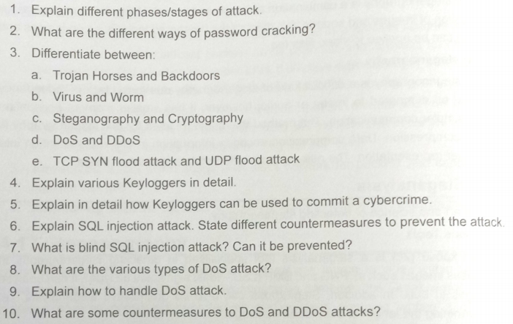
Sample questions

Slide 139
